Slide 1


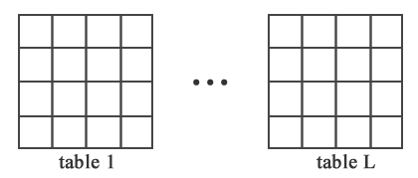
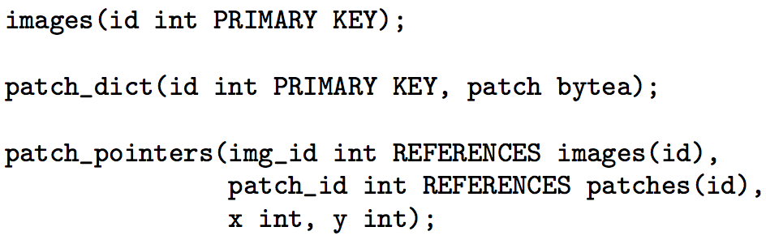
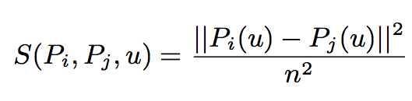
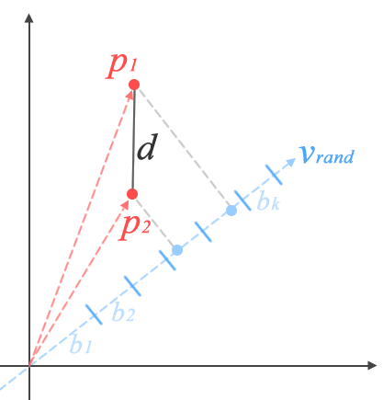
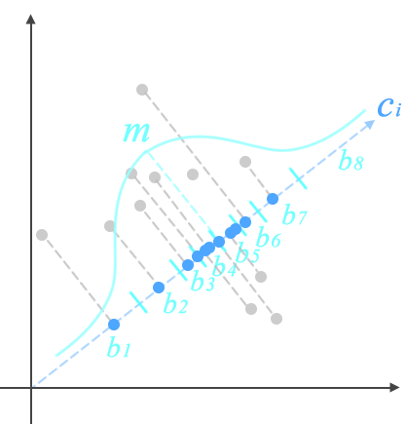
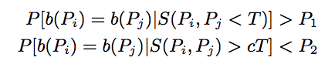
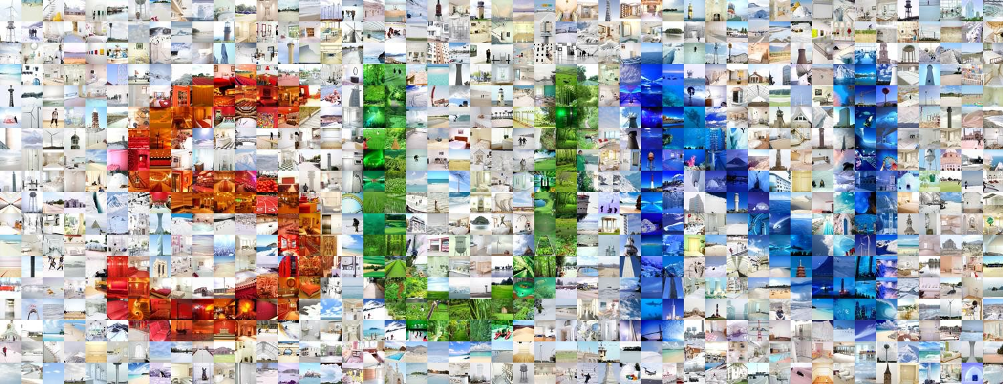
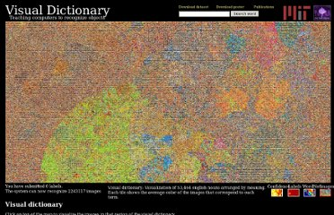
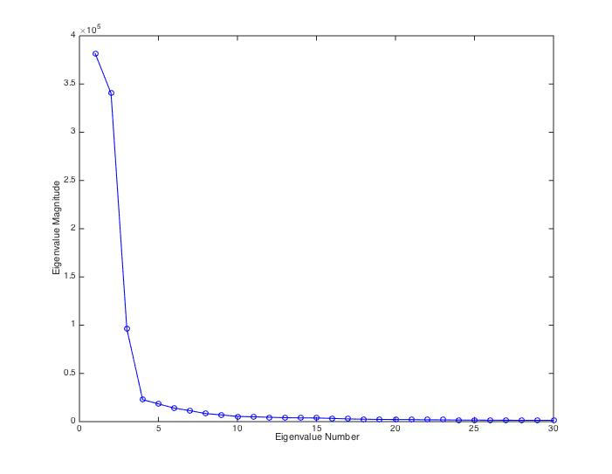
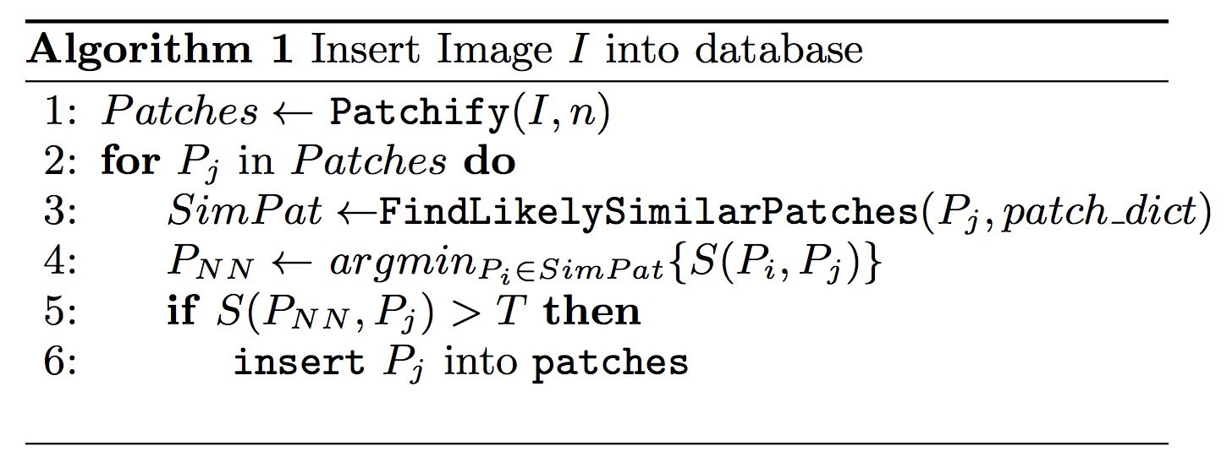
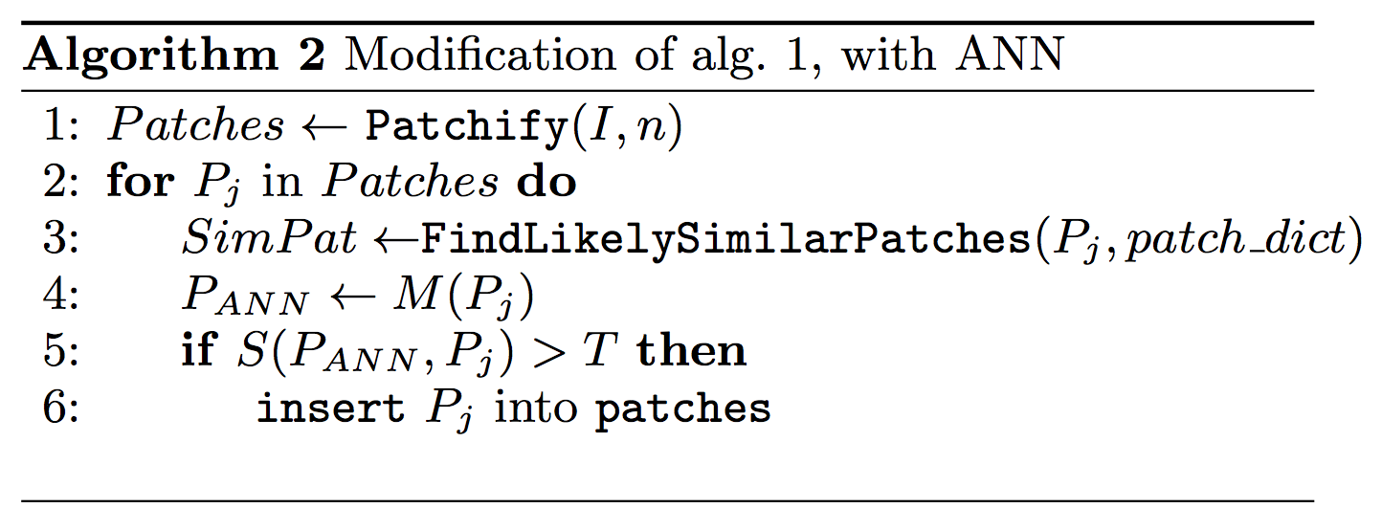
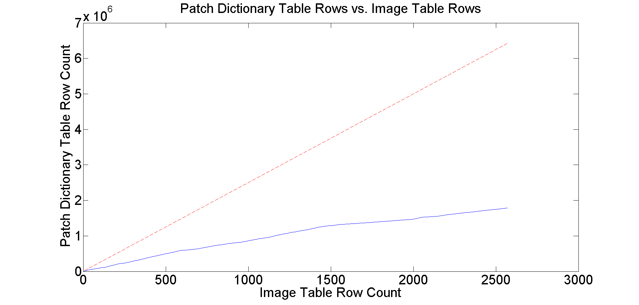
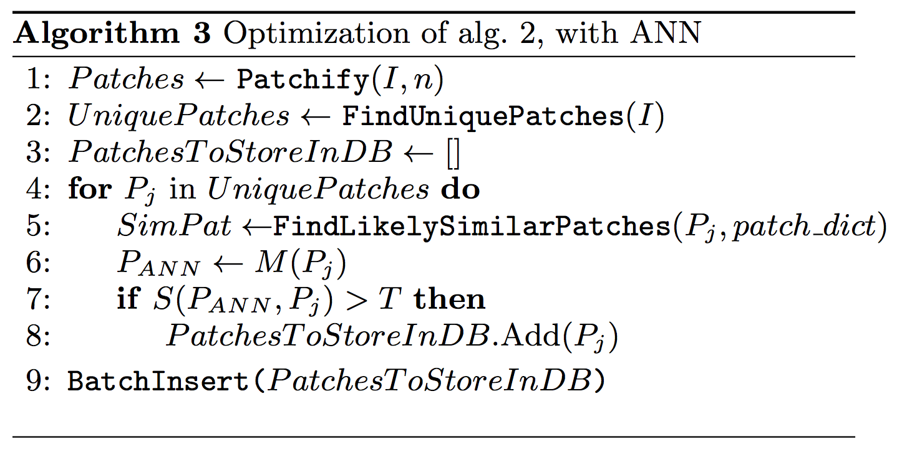
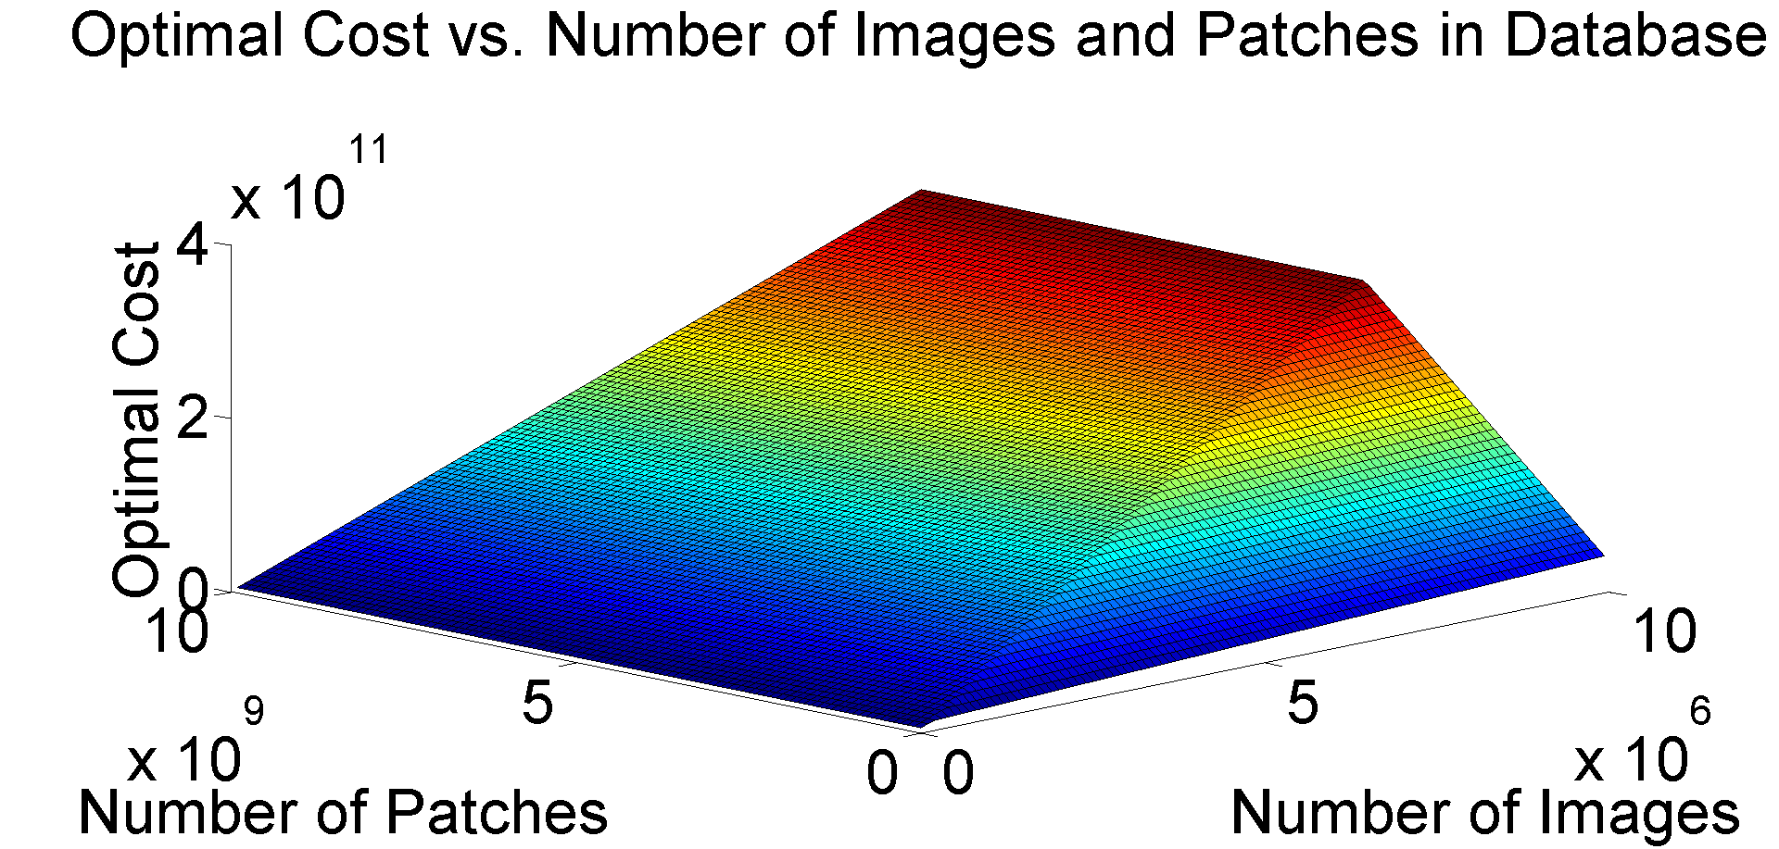
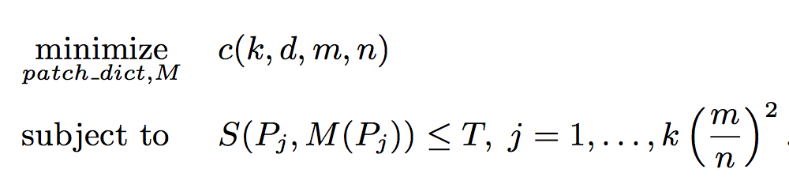
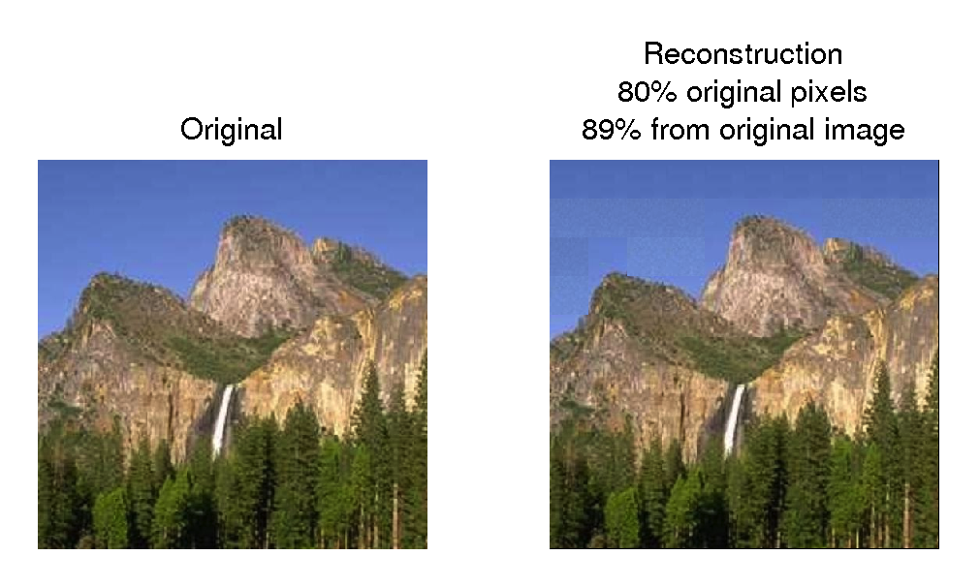
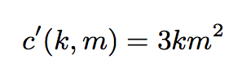
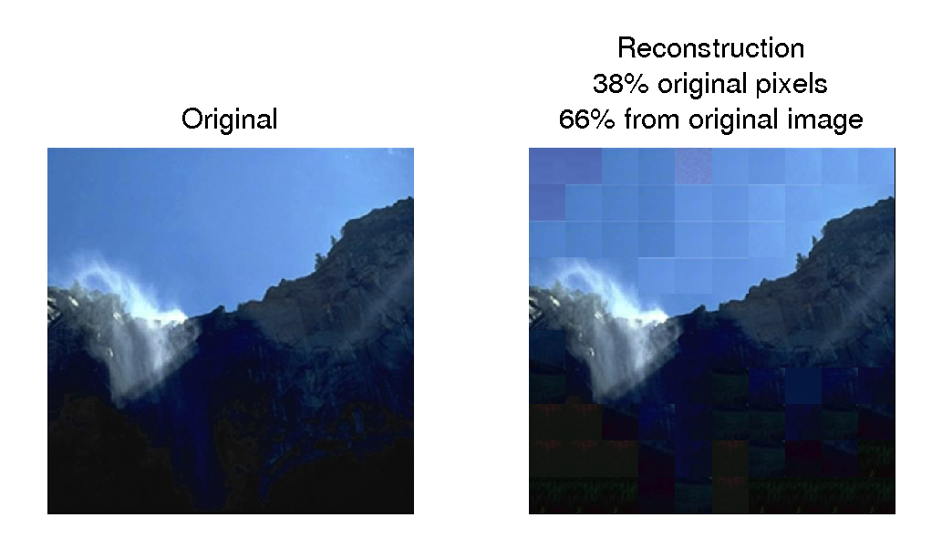
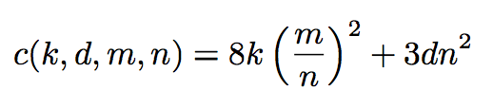
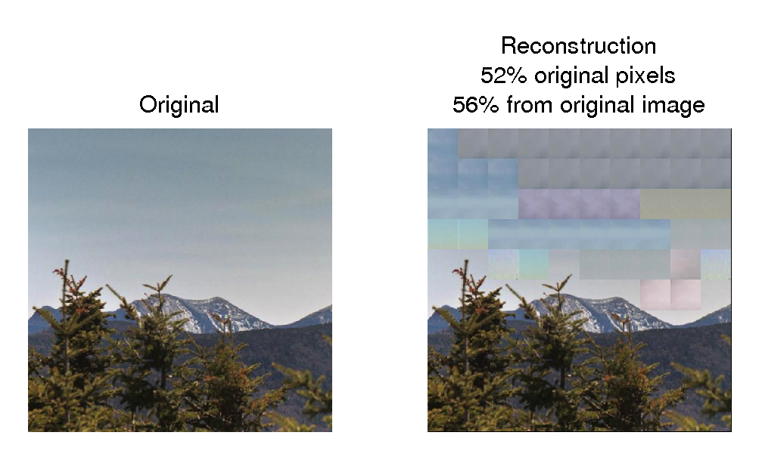
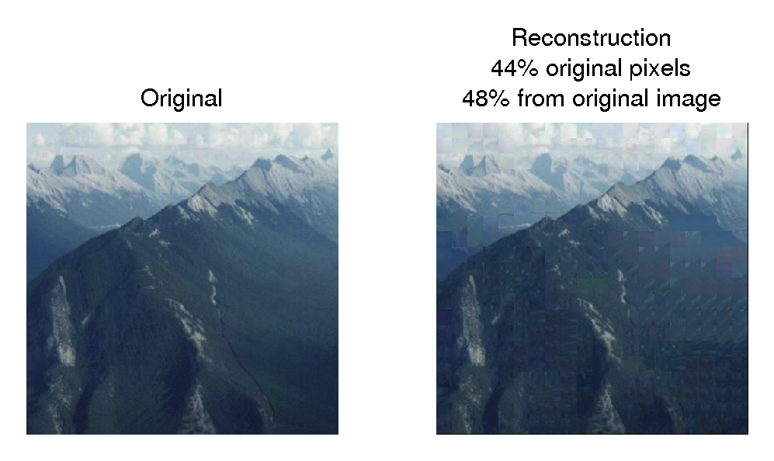
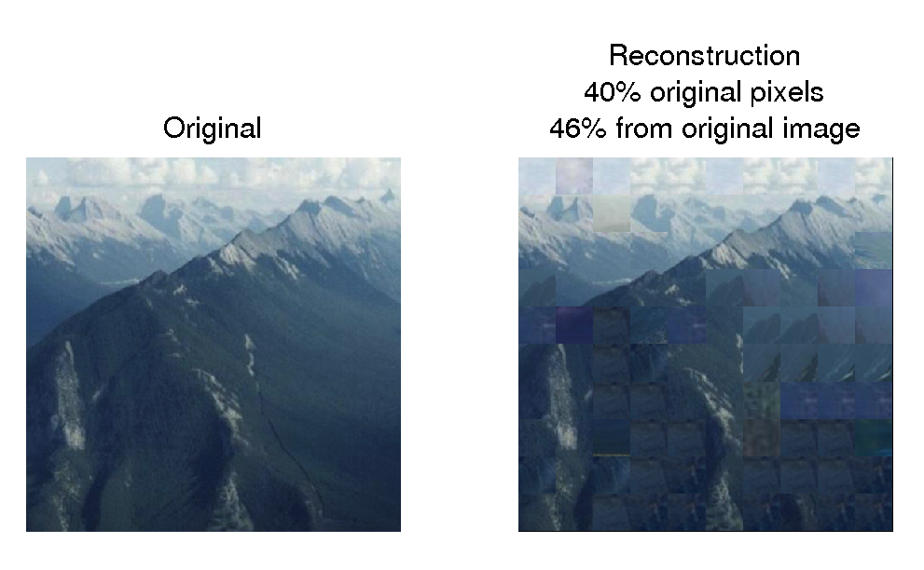
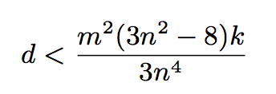
Rasterized Image Databases for Image Compression
6.830
Database Systems
Final Project
Zoya Bylinskii*, Maria Shugrina*, Andrew Spielberg*, Wei Zhao*
MOTIVATION
METHOD OVERVIEW
NEAR NEIGHBOR SEARCH
More than 1.8 billion images uploaded to the internet every day
Redundancy in large image collections can lead to more efficient storage
SCHEMA:
Distance per color channel
in CIE (LUV) color space:
LSH: AND and OR hashes for high precision/recall.
Can we find one AND hash for reasonable P1, low P2?
Random-projection hash
(we use AND of 10 in 32-bit int):
poor P1, P2
Using PCA directions as projection vectors to improve P1, P2
Thresholds T1, T2, T3 per channel.
ADDITIONAL INSIGHT:
Natural images contain many nearly uniform patches, which are easy to index and search:
uniform_patch_dict
Image size mxm, pach size nxn.
PCA-BASED HASHING:
Pick projection vectors to be directions of maximal variance in a subset of images.
ALGORITHM:
PATCH-BASED IMAGE CODING
Eigenvalues of patch sample.
Lossy compression
Compression savings INCREASE as the database size INCREASES
Rasterization is a simple operation – easily deconstruct and reconstruct images using patches
KEY OPTIMIZATIONS:
Minimize database queries (batch query per image)
Near-neighbor search
Patch BufferPool for patches (LRU)
Minimize re-computation of image vectors
Exploit image self-similarity
GENERALIZABILITY
Generalizability across image types:
within-image
(e.g. JPEG)
across-image
(our approach)
Compression
Big Data
Big Data
APPLICATIONS
duplicate detection
similar image retrieval
EXTENSIONS
DATABASE SCHEMA
int ID
IMPLEMENTATION:
context-aware patch sampling
task-aware threshold selection
patch hierarchies
int ID
images
patch_pointers
patch_dict
Posgresql database with Java API.
Image loading, patching, searching, hashing, Near-Neighbor search, reconstruction implemented in Java.
int img_ID
int patch_ID
[int,int] LOC
bytea PATCH
https://github.com/shumash/db_project
COST CALCULATIONS
PARAMETER SELECTION
Weighting storage savings and reconstruction speed against compression quality:
A number of factors, including the patch size, distance function, and threshold affect the costs of the patch-based compression scheme.
The importance of the right patch sampling technique:
The importance of the right color space and a threshold per color channel:
The importance of the right patch size:
The importance of the right distance function and threshold:
Cost without patch-based scheme:
Cost with patch-based scheme:
Constraint for cost savings:

